Slide 1


DS 6373 Time Series
COVID-19 Analysis and Forecasting
12/1/2020
Presenters
Jeremy Otsap jotsap@mail.smu.edu
Spencer Fogelman sfogelman@mail.smu.edu

Slide 2
Introductions
Spencer Fogelman - Data Analyst, Advanced Analytics at UCLA Health
Spencer is currently pursuing a Masters Degree in Data Science at Southern Methodist University while working as a data analyst at UCLA Health on the advanced analytics team. He helps to clean the data and engineer features for our machine learning models by working with subject matter experts and data scientists. Most of the projects I have worked on have involved using NLP and deep learning for predictive modeling. Prior to UCLA, Spencer got a Bachelors of Science in Biology and Pre-medical studies from Emory University in Atlanta, and used his education to work as a lab technician in various labs at UCLA researching cancer.
Jeremy Otsap - Technical Director, Cloud & Data Architecture
Jeremy first got his start with computers when he was 13-years old with MS-DOS v5. Since then, he has spent the past 24 years on multiple aspects of technology from system engineering, network architecture, data center build-out, cloud migration, optimization & modernization, compliance audit & remediation, and big data deployments. He has worked as an IT Director at True Religion Jeans and BCBG, having deep industry expertise in Retail, Manufacturing, and Supply Chain Management. He has over a dozen IT certifications from Microsoft, VMware, Cisco, and NetApp, and additionally a Data Science Graduate Certificate from UC Irvine, while actively pursuing his Masters in Data Science.

Slide 3
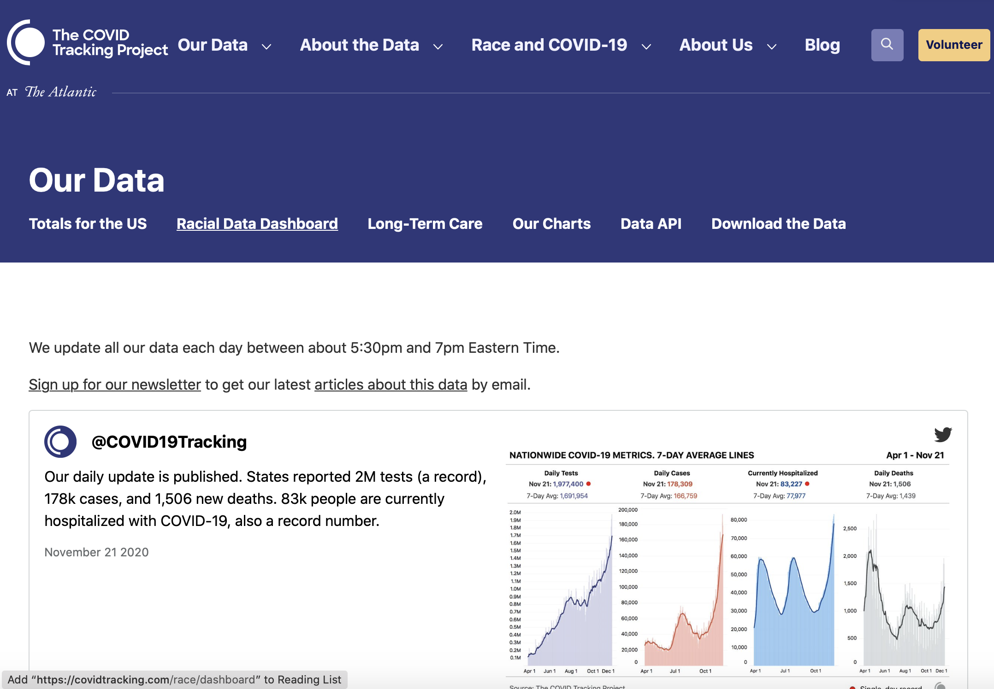
Data Source: The COVID Tracking Project
Volunteer Project Launched from the Atlantic

Slide 4

Data Cleaning and Assumptions
CA only started reporting death 3/12 and hospitalizations 3/27: date range used for model training was 3/27 to 11/30
For the US analysis we excluded US territories
Many metrics from the Atlantic were reported as cumulative: we differenced the data to get daily values
We assumed the total number of cases were the sum of the reported positive and negative cases

Slide 5
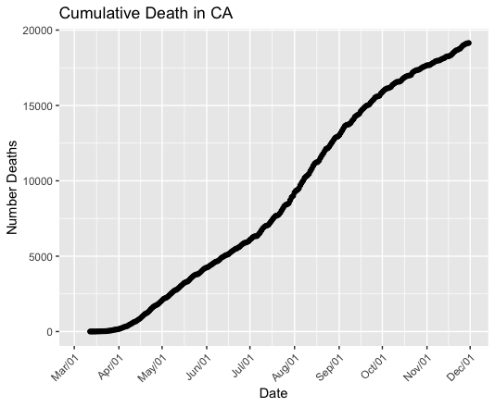
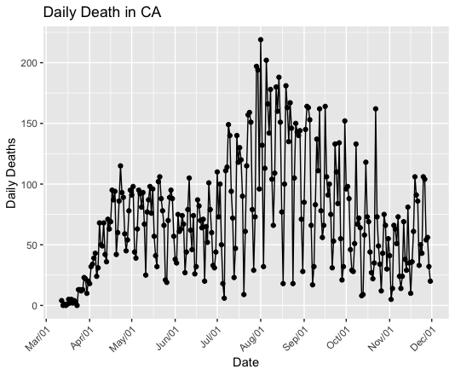
Death in CA
Cumulative Death
Total: 19,089 deaths
Daily Death
Yesterday: 20 deaths

Slide 6
Top 5 Across the US: How does CA compare? - 5.02% Positivity Rate | 43rd lowest in US
state | totalPos | totalNeg | totalDeath | totalTests | posRate | deathRate
CA | 1183320 | 22389862 | 19089 | 23573182 | 0.05019772 | 0.0008097761
TX | 1151069 | 9485780 | 21309 | 10636849 | 0.10821522 | 0.0020033188
FL | 969813 | 6197289 | 18677 | 7167102 | 0.13531452 | 0.0026059347
IL | 712936 | 9655342 | 12838 | 10368278 | 0.06876127 | 0.0012381998
NY | 634438 | 18480766 | 26632 | 19115204 | 0.03319023 | 0.0013932365
Top 5 States by Total Positive
state | totalPos | totalNeg | totalDeath | totalTests | posRate | deathRate
NY | 634438 | 18480766 | 26632 | 19115204 | 0.03319023 | 0.0013932365
TX | 1151069 | 9485780 | 21309 | 10636849 | 0.10821522 | 0.0020033188
CA | 1183320 | 22389862 | 19089 | 23573182 | 0.05019772 | 0.0008097761
FL | 969813 | 6197289 | 18677 | 7167102 | 0.13531452 | 0.0026059347
NJ | 330275 | 5613309 | 16965 | 5943584 | 0.05556832 | 0.0028543384
Top 5 States by Total Death
state | totalPos | totalNeg | totalDeath | totalTests | posRate | deathRate
SD | 79099 | 246277 | 942 | 325376 | 0.2431003 | 0.002895112
ND | 77935 | 269446 | 680 | 347381 | 0.2243502 | 0.001957505
ID | 98500 | 385159 | 909 | 483659 | 0.2036559 | 0.001879423
KS | 153021 | 659403 | 1529 | 812424 | 0.1883512 | 0.001882022
IA | 199683 | 863998 | 2360 | 1063681 | 0.1877283 | 0.002218710
Top 5 States by Positivity Rate

Slide 7
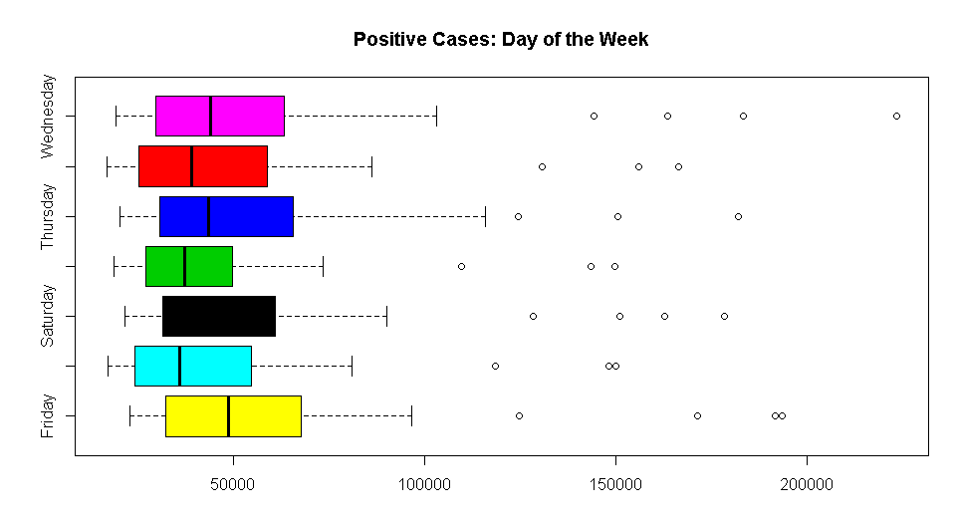
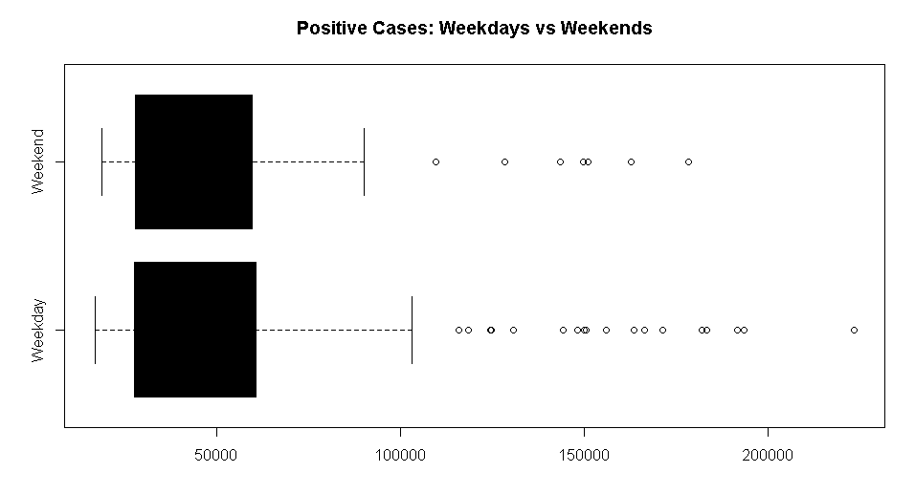
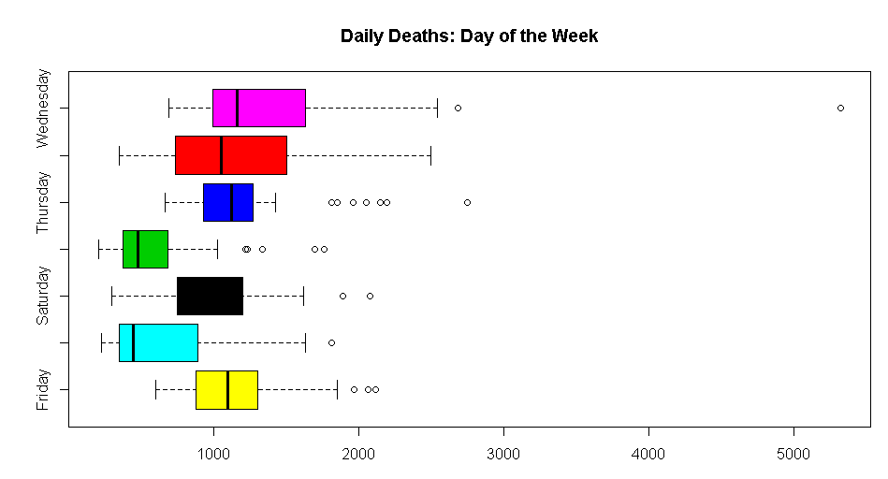
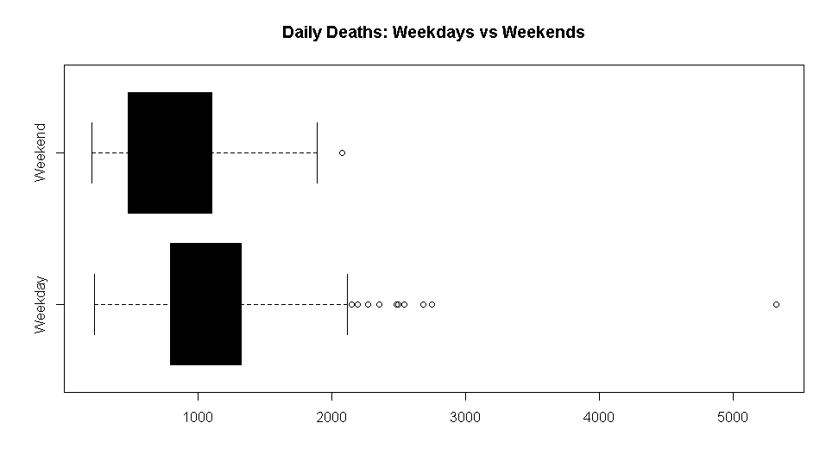
Weekend Effect on Daily Deaths and Positive Cases

Slide 8
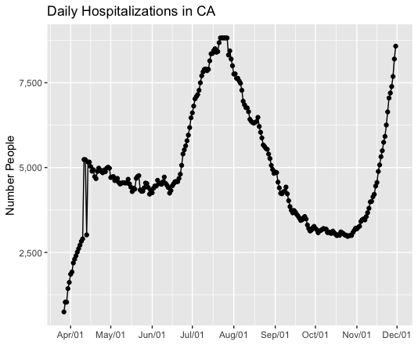
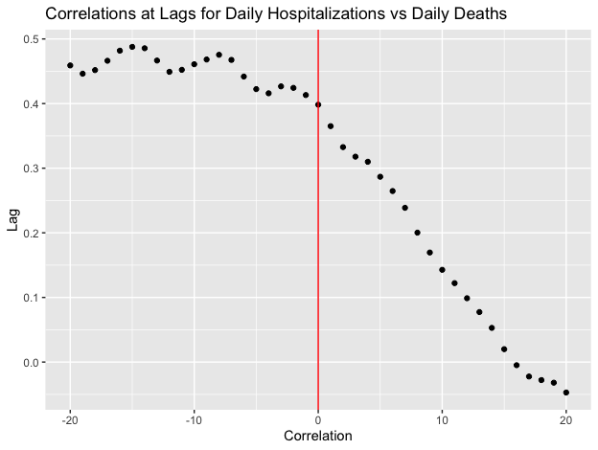
Death Models Predictor: Current Hospitalizations
Daily Current Hospitalizations
Cross Correlation with current Deaths
Moderate Correlation at negative lags indicates that daily hospitalizations is a leading predictor of death

Slide 9
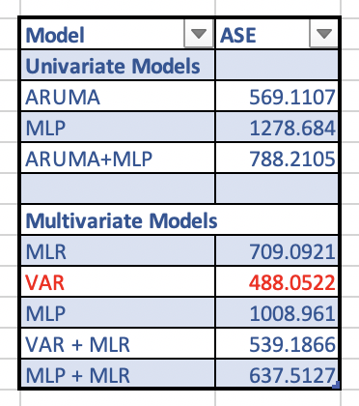
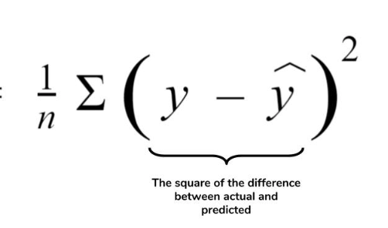
Candidate Models
Selected VAR model because it had the lowest ASE
We calculated the ASE by comparing the last 20 predicted values to the last 20 actual values
ASE =

Slide 10
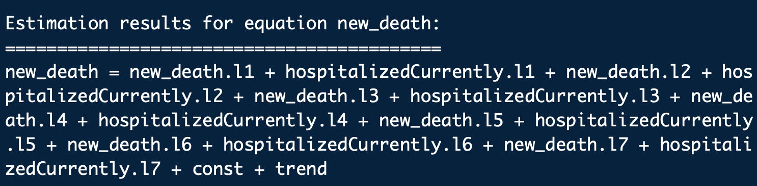
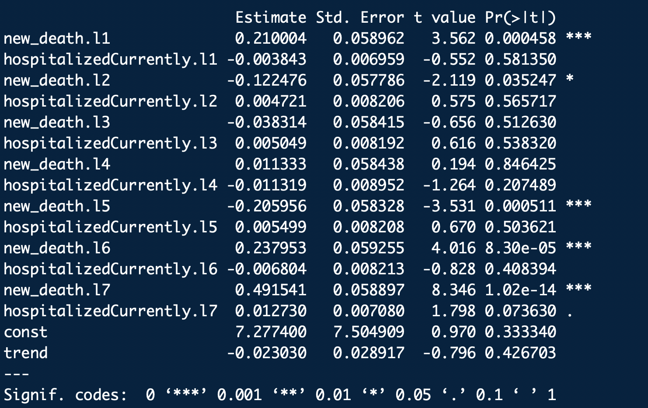
VAR(7) Model for Daily Death in CA
Used Current hospitalization as a covariate
VAR(7) predicts that daily death will be a weighted combination of the previous daily deaths and hospitalizations of the last 7 days
The most significant contributors to predictions were the deaths the previous one, two, five, six, and seven days, and also the hospitalizations the week before

Slide 11
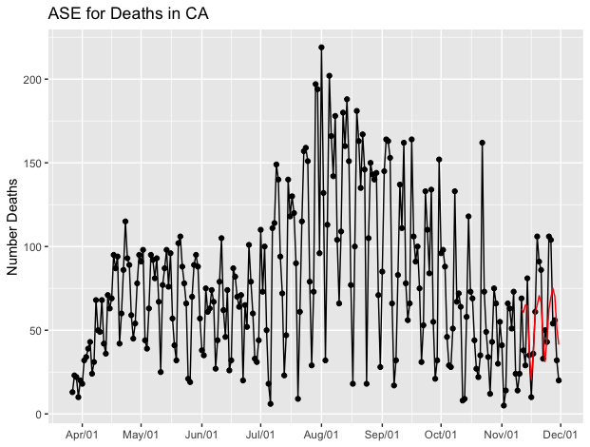
VAR ASE Graph
Value = 488.0522
Predicted death in red while actual death in black

Slide 12
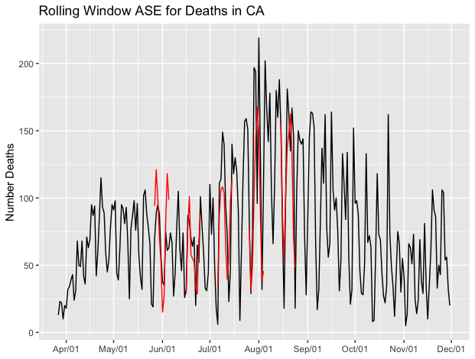
Rolling window ASE
Value= 1235.803
Rolling window ASE if the average ASE over 5 different slices of the data. Model seems to generalize pretty well

Slide 13
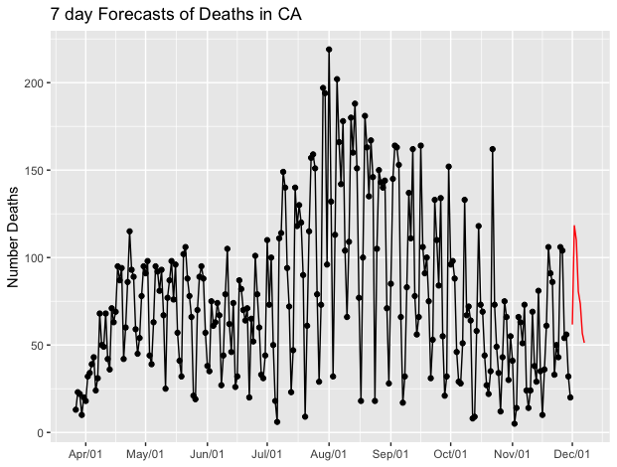
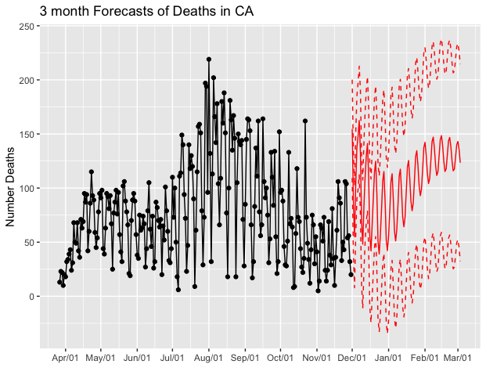
VAR Forecasts
Forecasts become less certain in general the farther out you forecast. This is quantified by the confidence intervals, which are the red dotted lines.
Next 7 Days
Forecasted Death on Day 7: 51 deaths
Next 3 months
Forecasted death on Day 93: 71 deaths

Slide 14
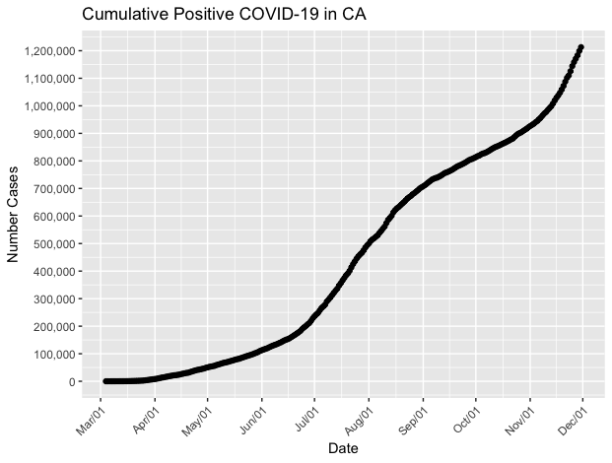
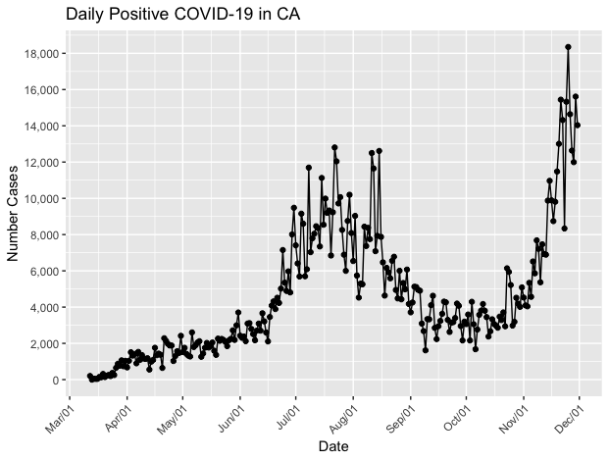
COVID-19 Cases in CA
Seems to be an overall upward trend in the number of daily COVID cases
Cumulative Total
Total:1,212,968
Daily Cases
Yesterday:14,034

Slide 15
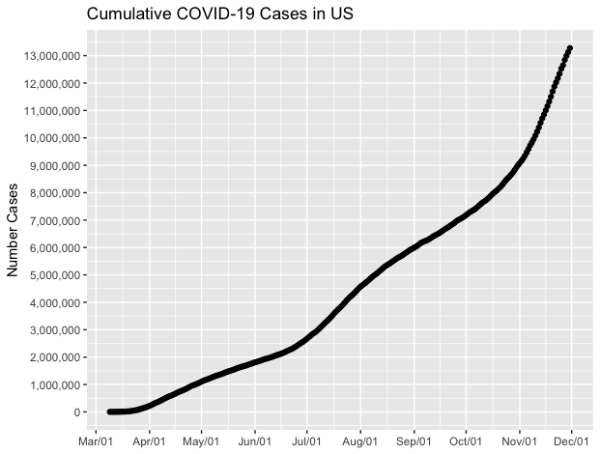
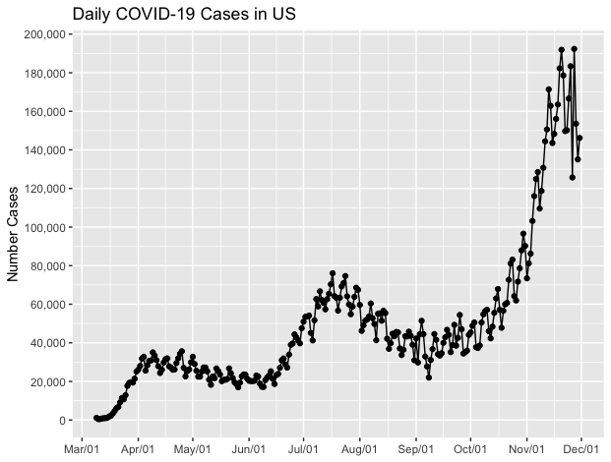
COVID-19 Cases in US
COVID Cases in US have similar upward trend
Cumulative Cases
Total: 13,276,922
Daily Cases
Yesterday: 146,195

Slide 16
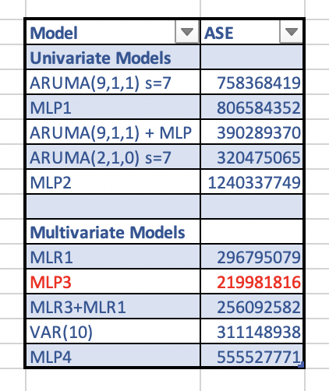
Candidate Model Slide
Best Model based on the ASE (calculated on last 20 observations) was the Multilayer Perceptron using the additional explanatory variables of time and a weekend indicator variable

Slide 17
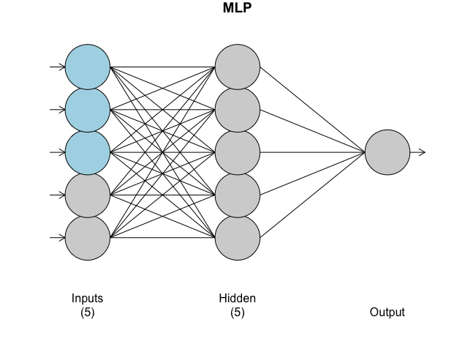
MLP Structure
MLP is a type of neural network
Black Box Model: outputs predictions without showing the data scientist the actual calculations used to transform input variables to predictions
Predictor variables: time, whether it was a weekend, and previous daily positive COVID cases

Slide 18
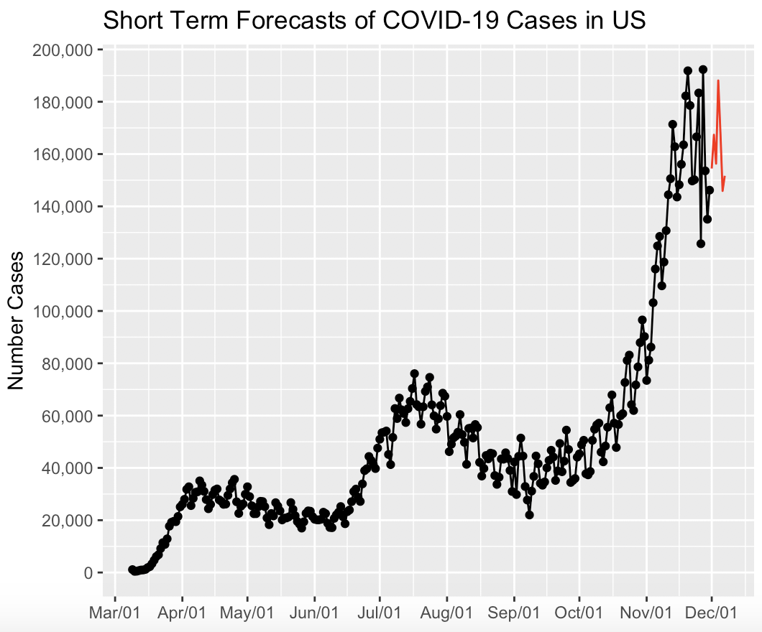
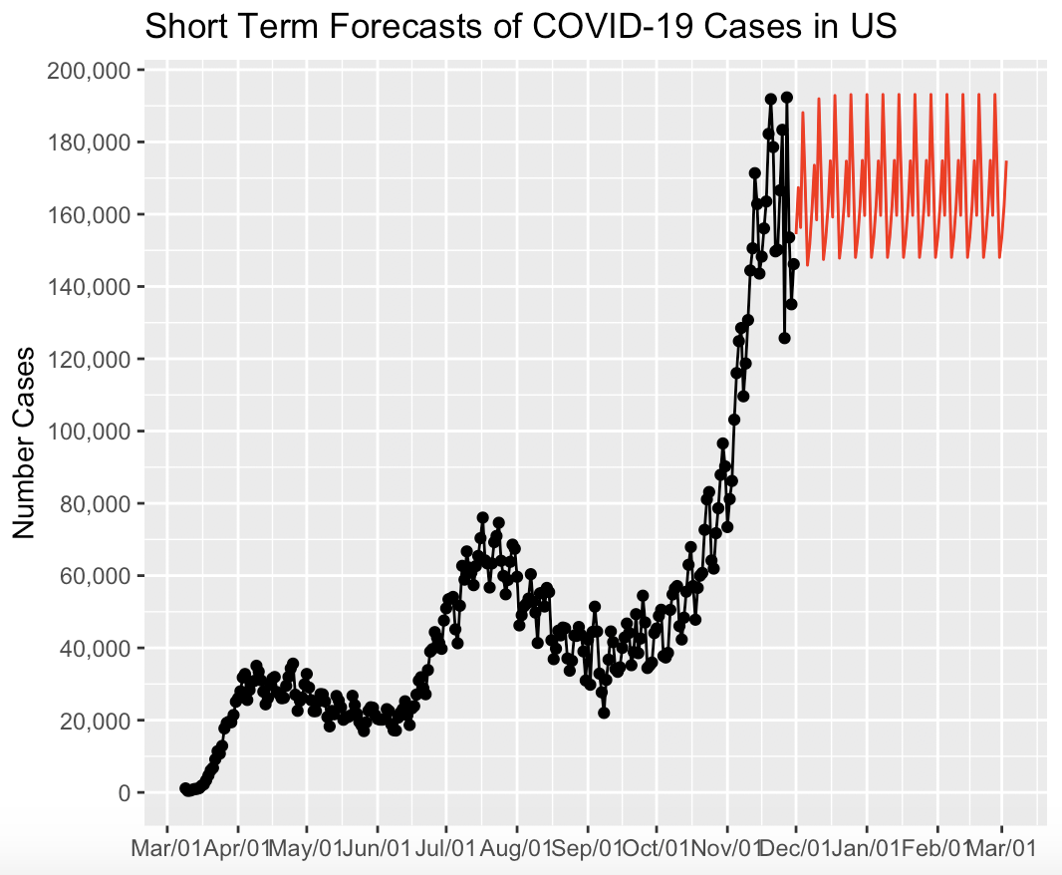
MLP Forecasts
Forecasts become less certain as time goes on but we cannot get these actual limits with neural networks
Next 7 days
Forecasted Number of Cases 7 days from now: 151,323
Next 3 months
Forecasted Number of Cases 3 months from now: 174,323

Slide 19
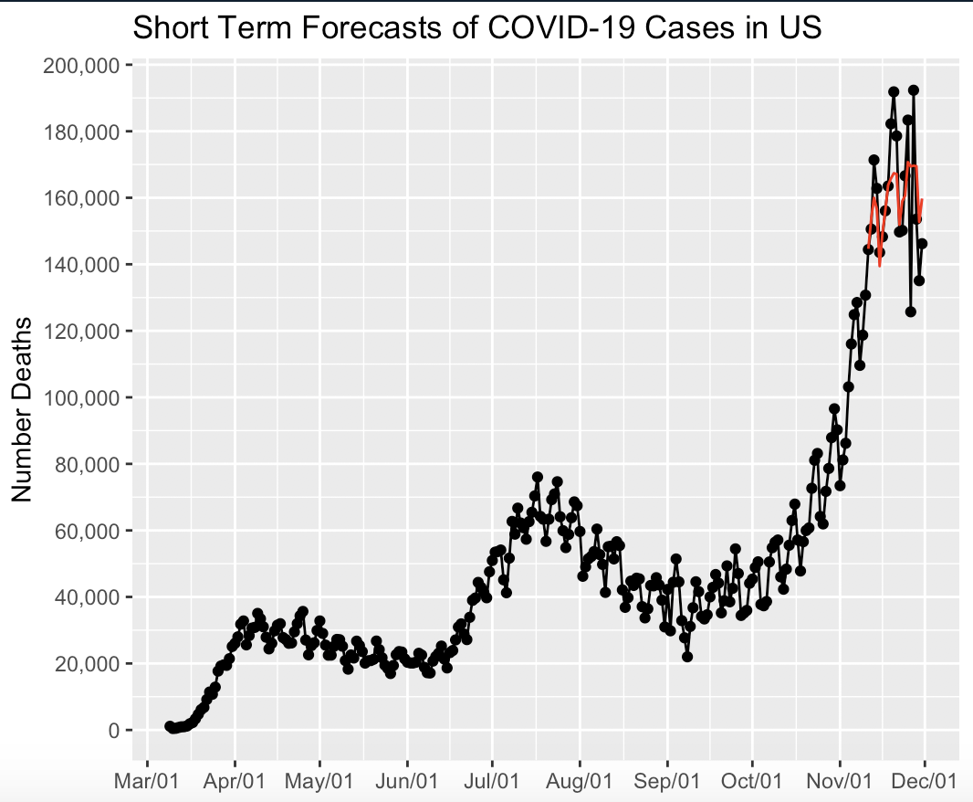
Multilayer
Perceptron ASE
The general cyclic pattern and troughs seems to be captured well

Slide 20
Final Thoughts
Spencer Models: US Positive Cases
Jeremy Models: US Positive Cases
UNIVARIATE
ARUMA(9,1,1)| s=7: 758,368,419
MLP: 806,584,352
ARUMA + MLP: 390,289,370
MULTIVARIATE
MLR(t,weekend): 296,795,079
MLP(t,weekend): 219,981,816
Ensemble(MLR + MLP): 256,092,582
UNIVARIATE
ARUMA(2,1,0)| s=7: 320,475,065
MLP: 1,240,337,749
Ensemble: 600,912,37
MULTIVARIATE
VAR(7)|(positive, hospital, death): 811,065,445
MLP(t, weekend, hospital): 535,947,347
Ensemble: 600,825,455

Slide 22
Appendix

Slide 23
Univariate Forecasts
Forecasted Daily Death in CA

Slide 24
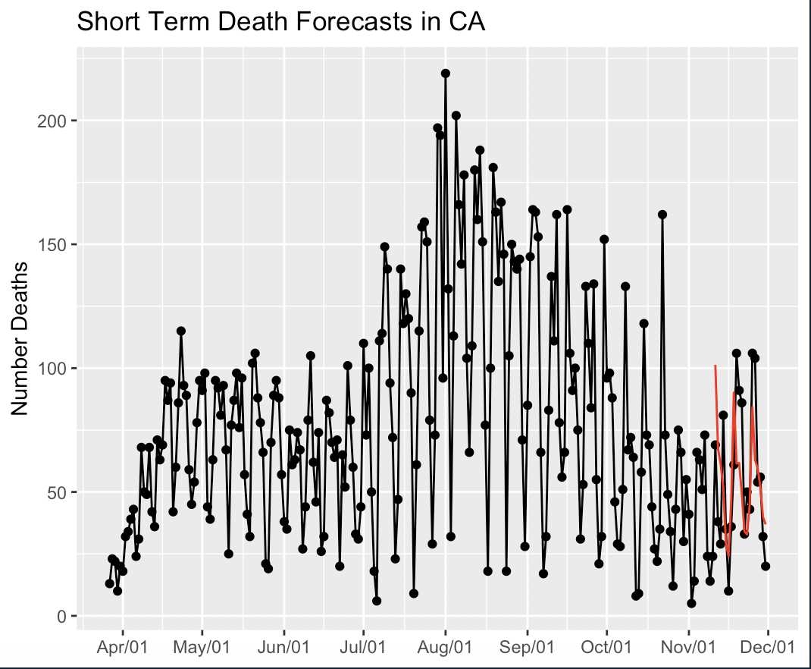
ARUMA ASE 569.1107

Slide 25
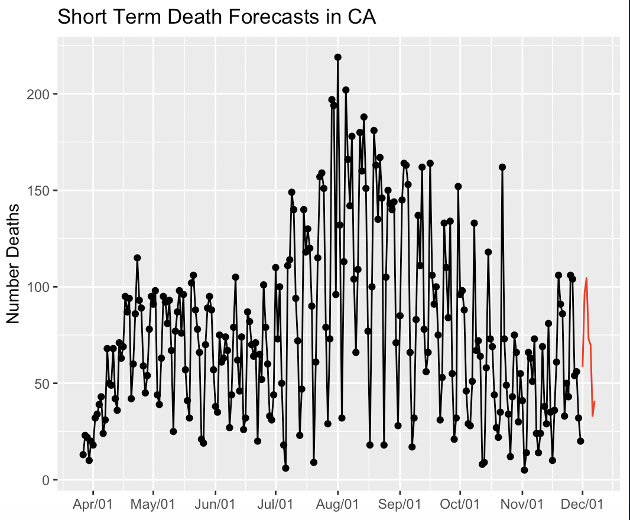
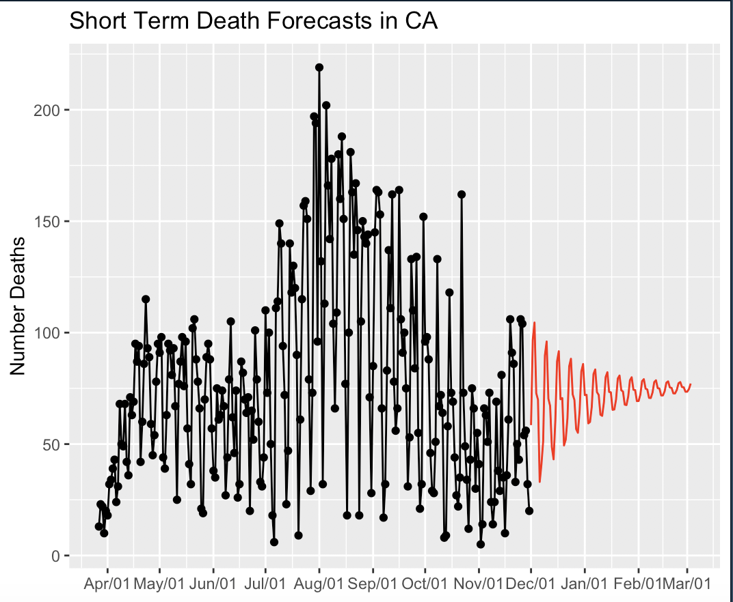
ARUMA forecasts
7 days
93 days

Slide 26
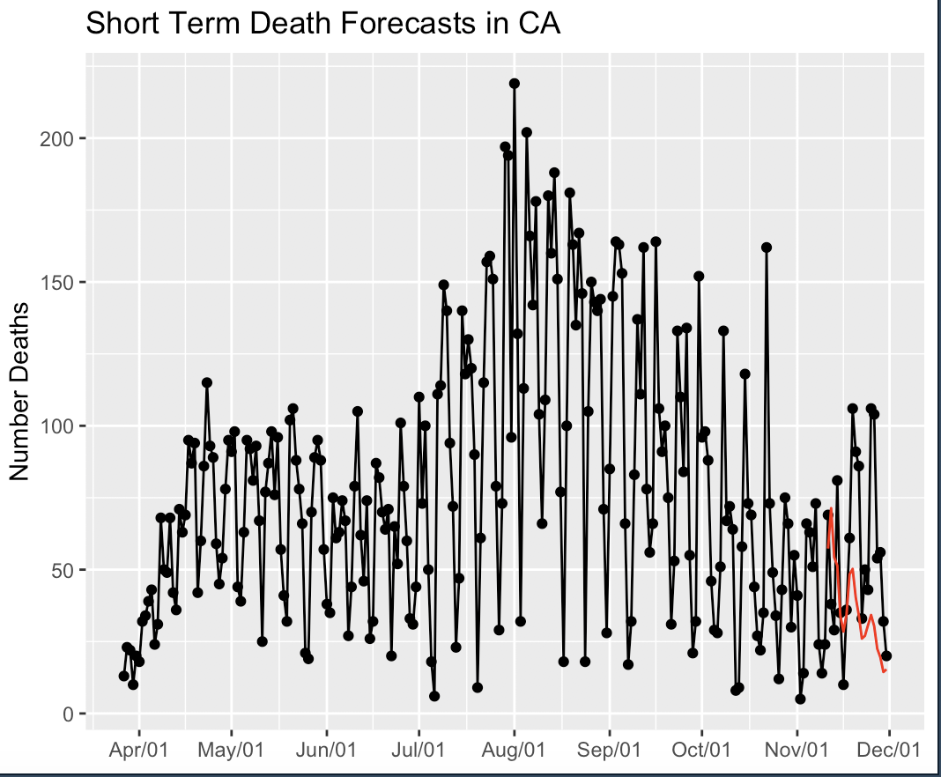
Univariate Multilayer Perceptron ASE ASE = 1278.684

Slide 27
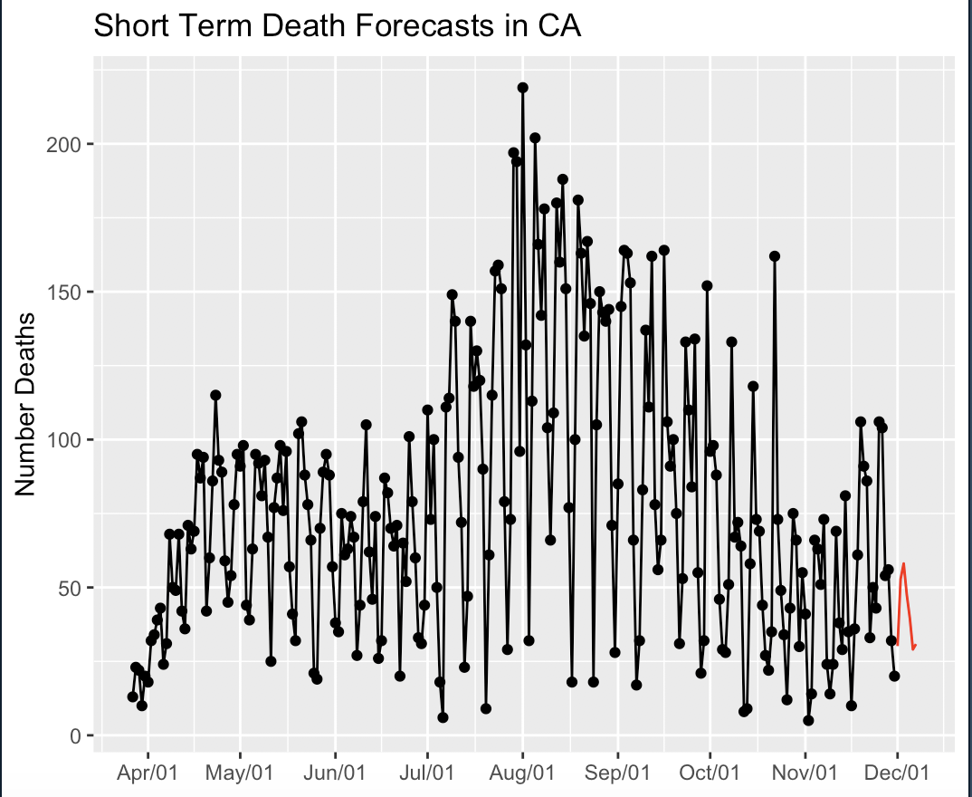
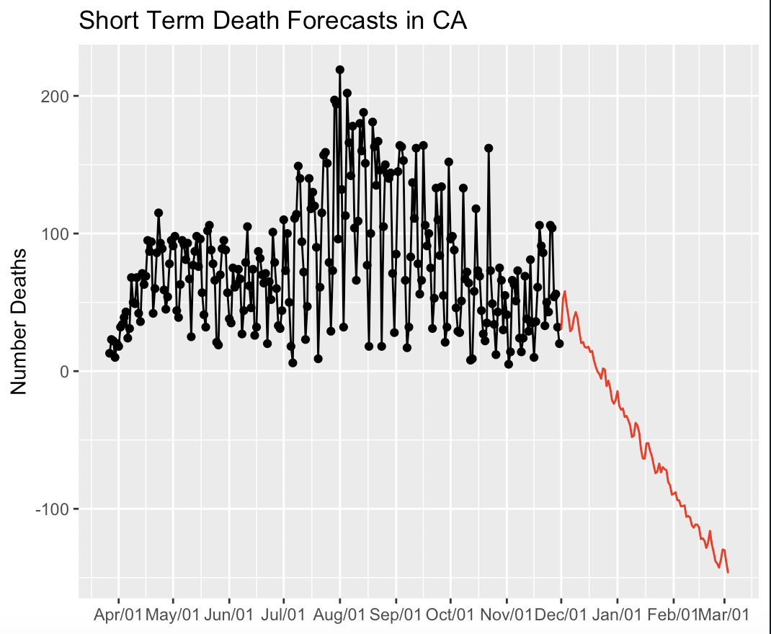
Univariate MLP forecasts
7 days
93 days

Slide 28
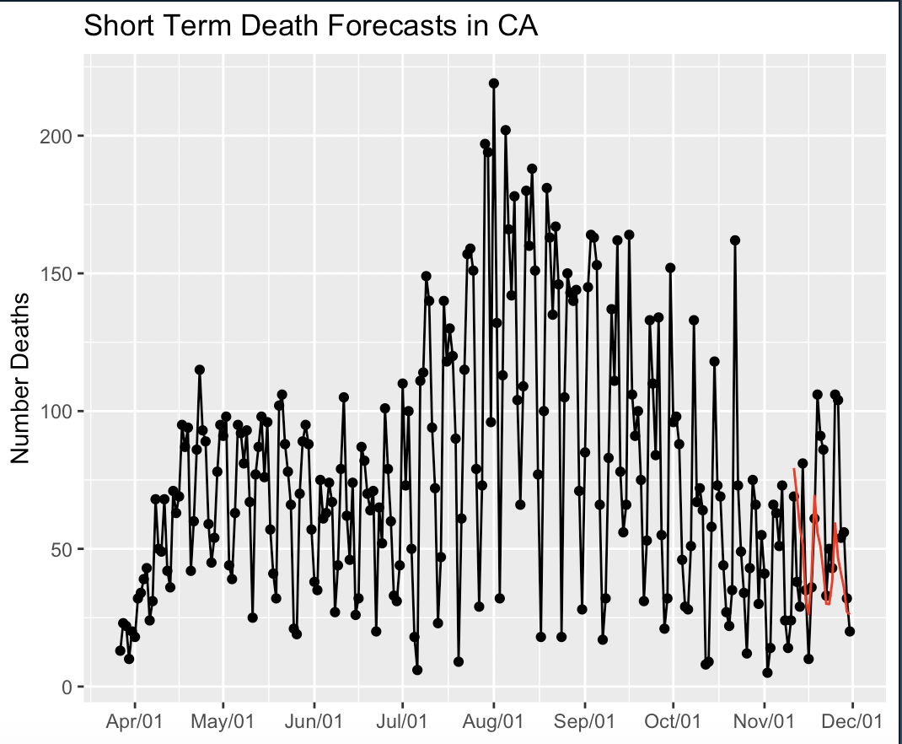
Ensemble ASE 788.2105

Slide 29
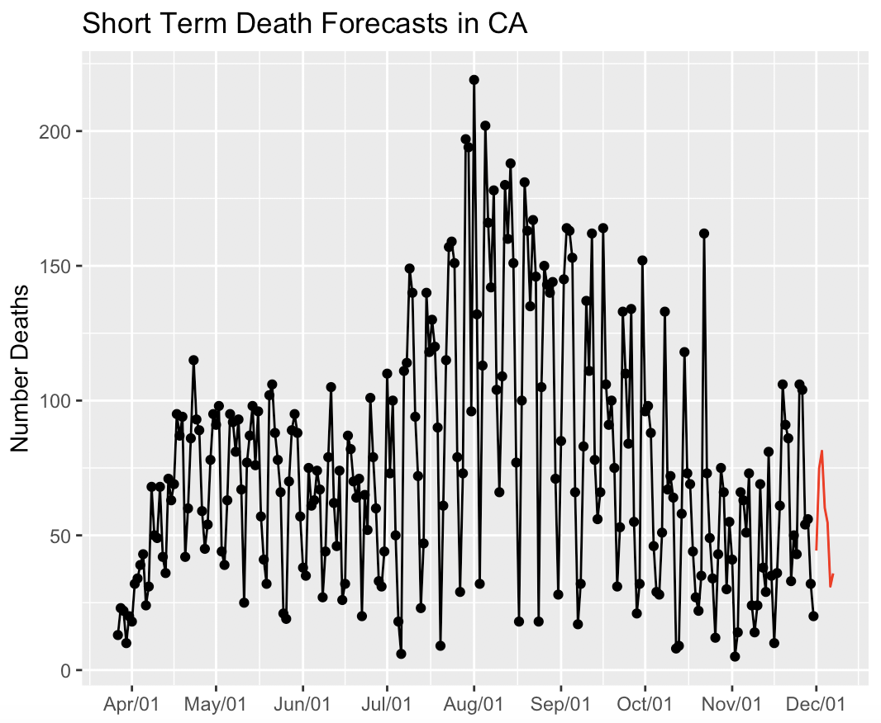
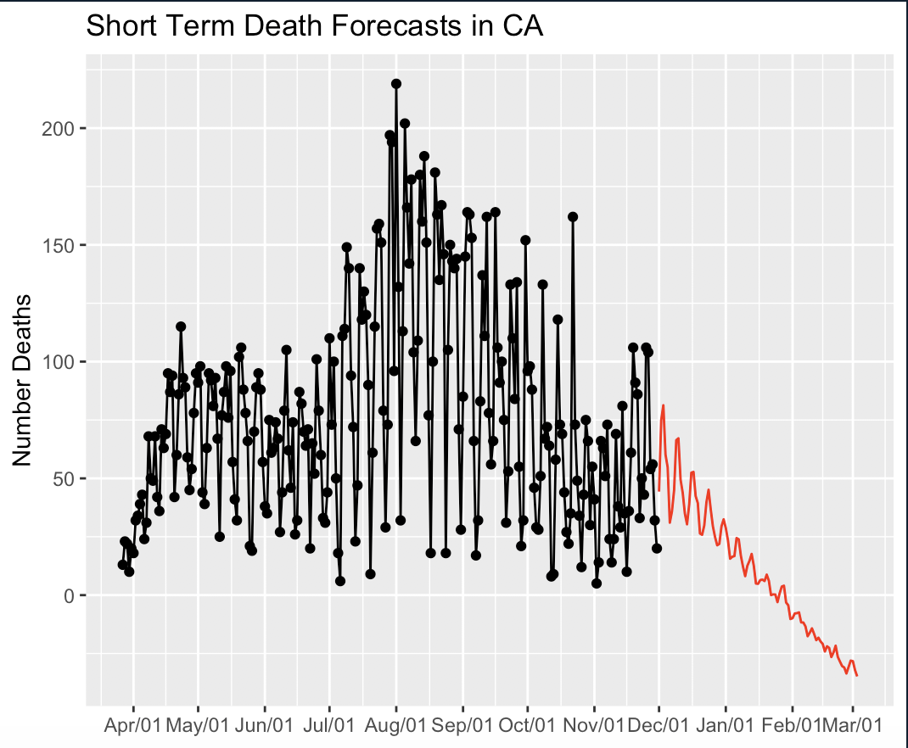
Ensemble Forecasts
7 days
93 days

Slide 30
Multivariate Forecasts
Added current hospitalizations to forecast daily death in CA

Slide 31
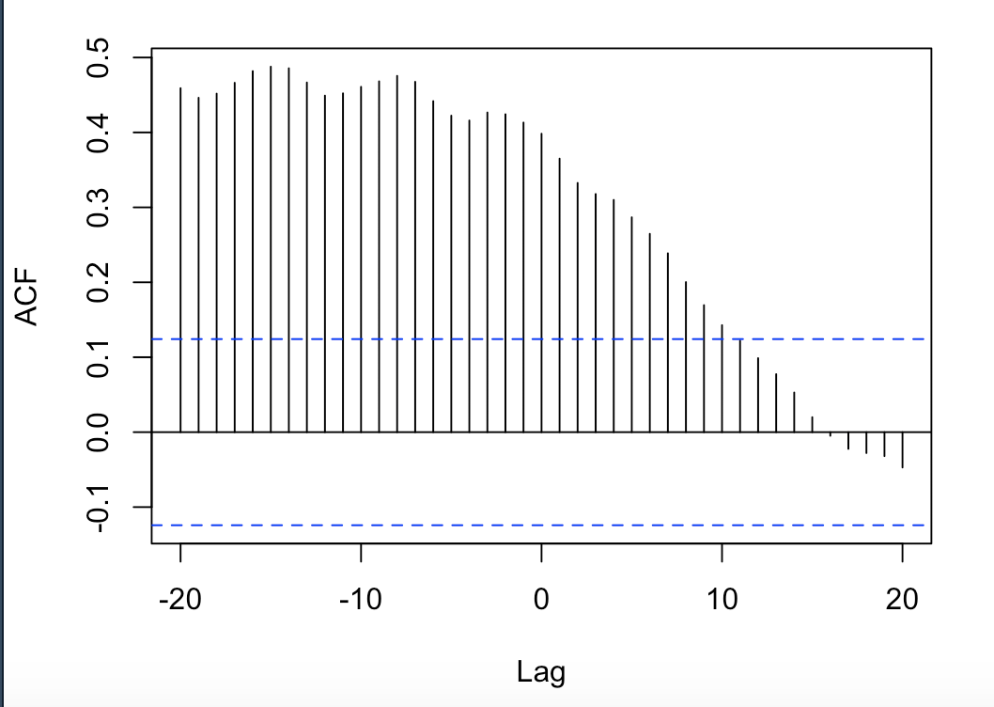
Multivariate Linear Regression with correlated errors
Use Hospitalizations as predictors
Found that current number of hospitalizations 8 days prior were associated with current daily deaths
Add Title to graph and point out peak at lag 8

Slide 32
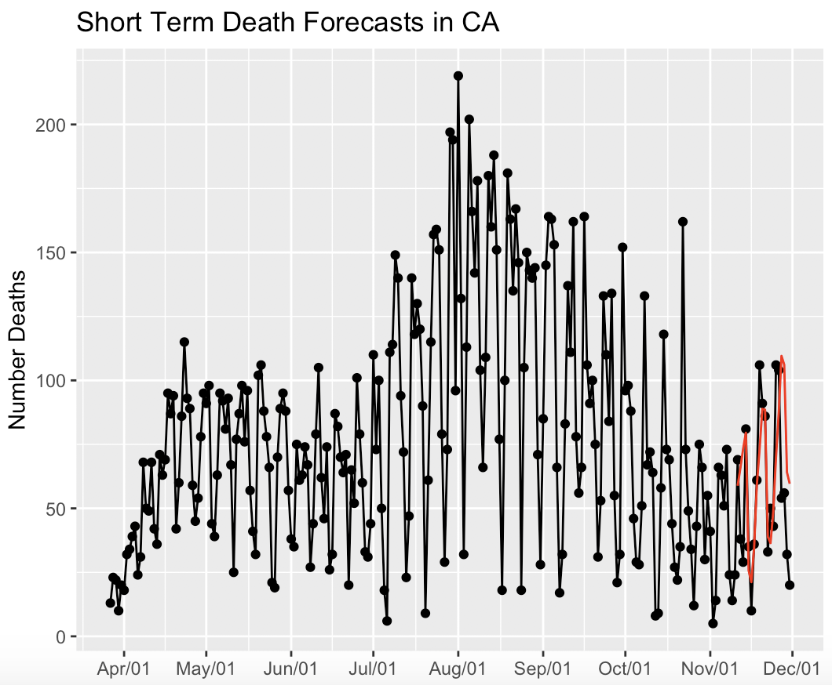
Multivariate Linear Regression with correlated errors ASE ASE = 709.0921

Slide 33
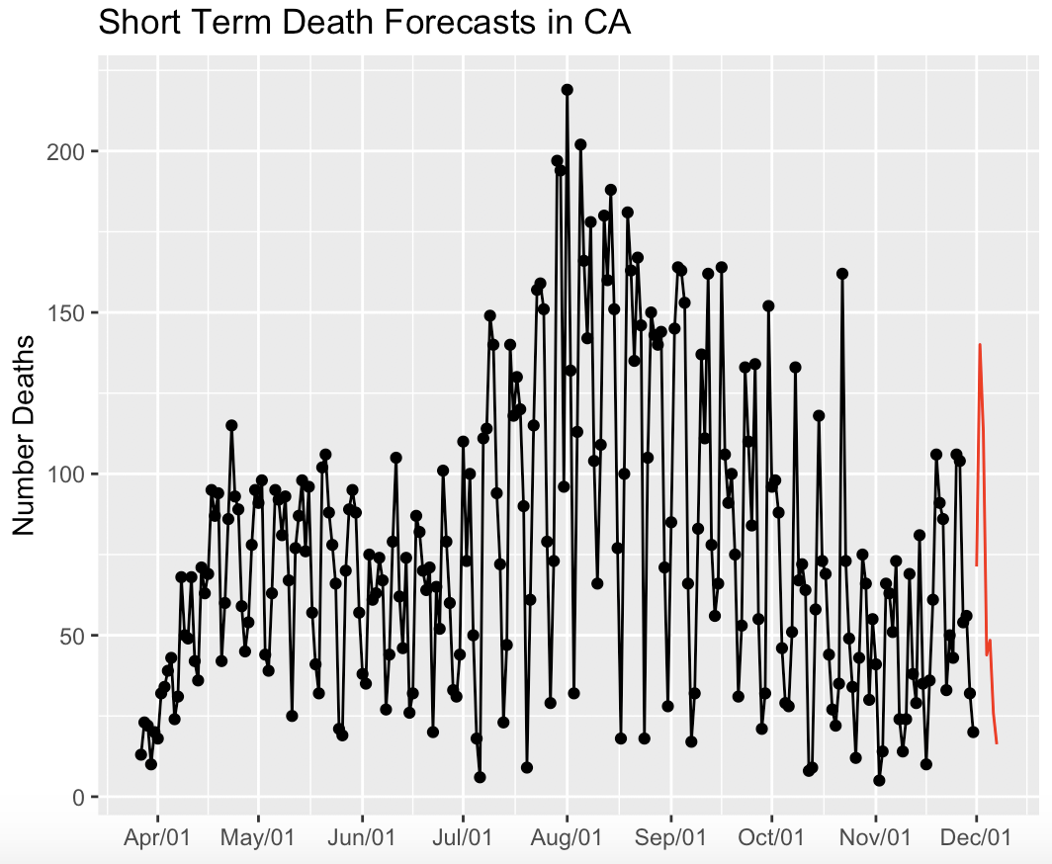
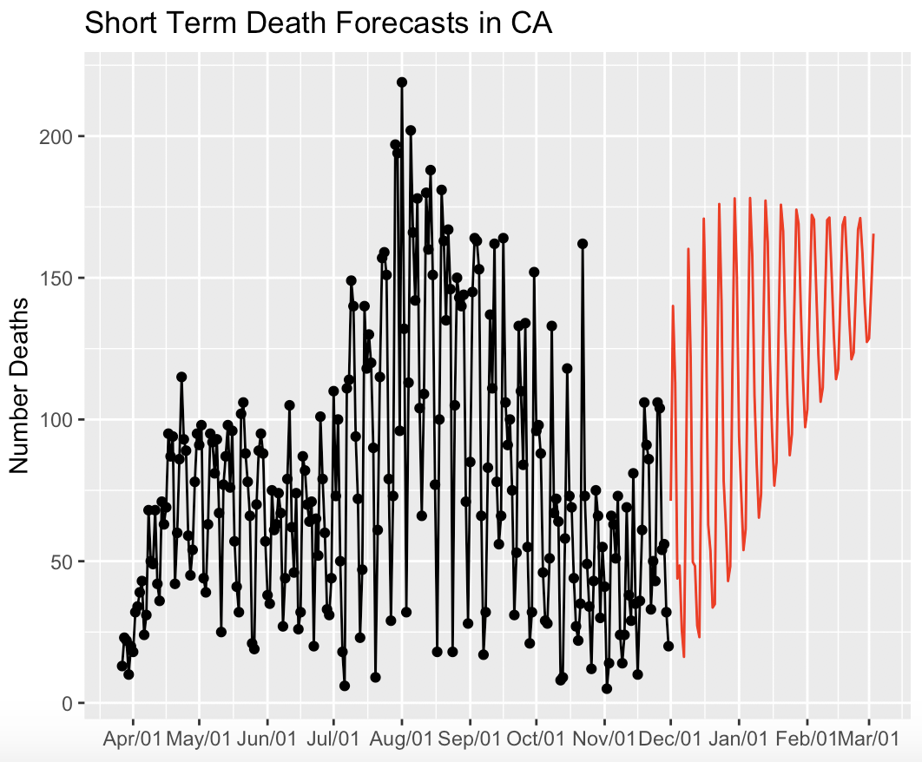
Forecasts
7 days
93 days

Slide 34
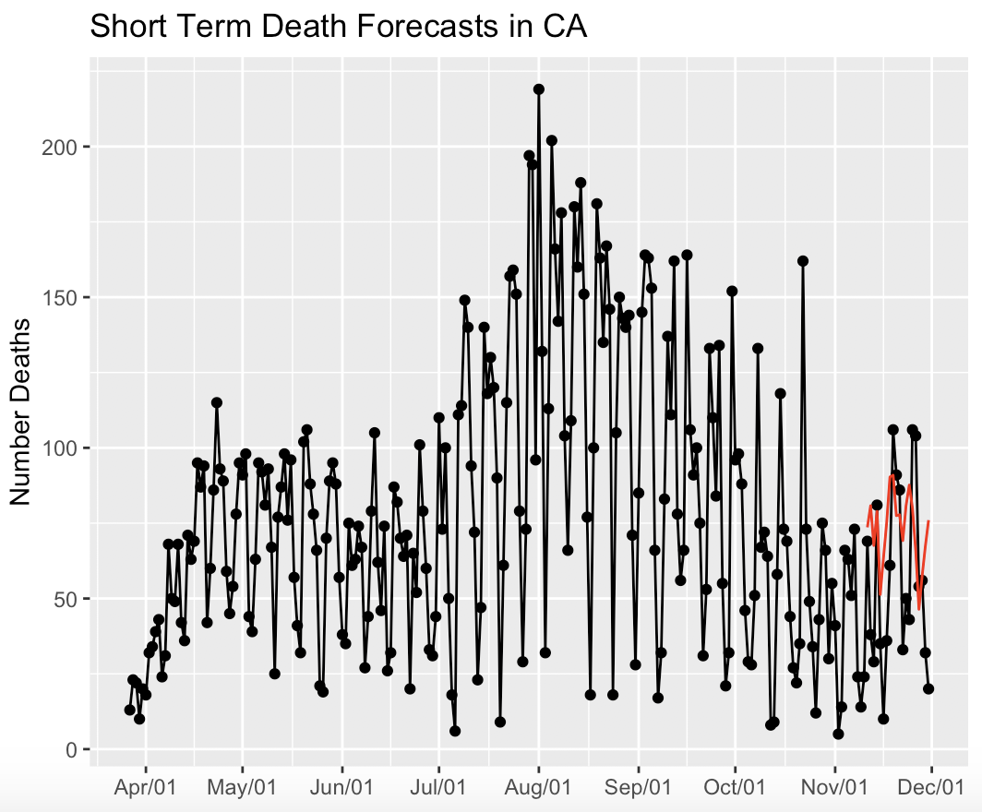
Multivariate Multilayer Perceptron ASE ASE = 1008.961
Included current hospitalizations as a predictor
And let the neural network choose its lags

Slide 35
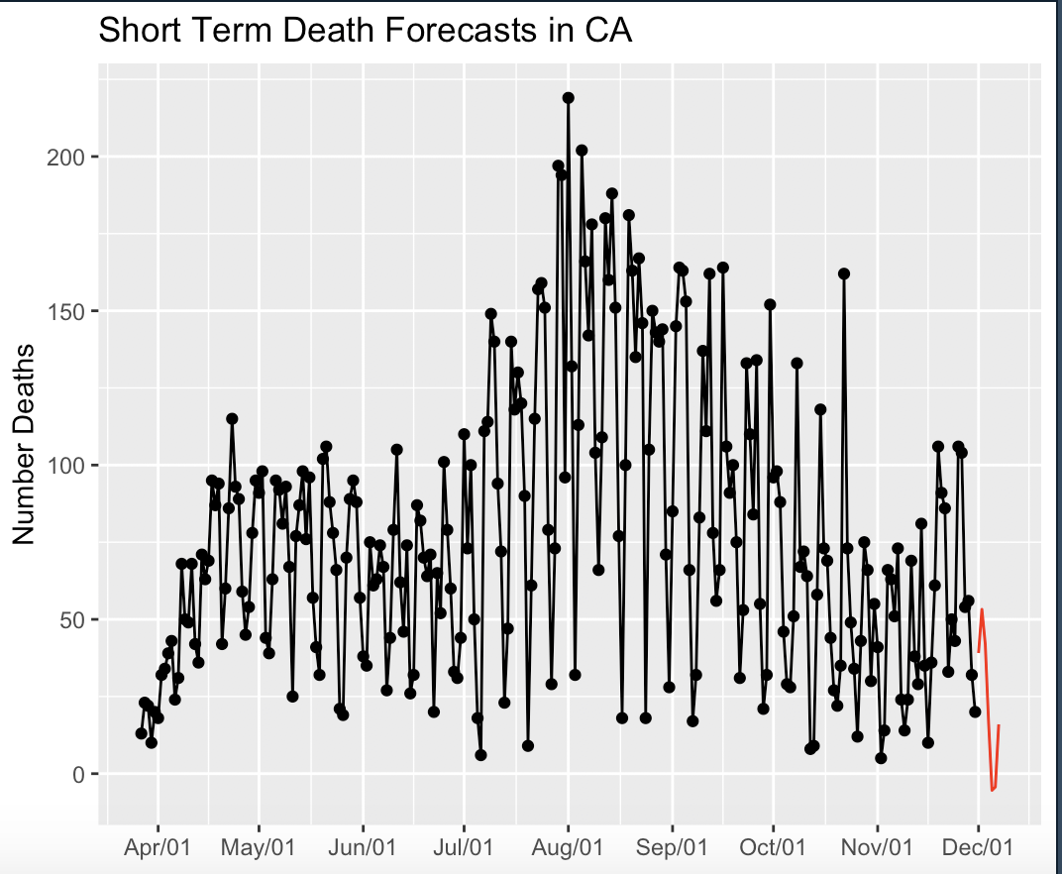
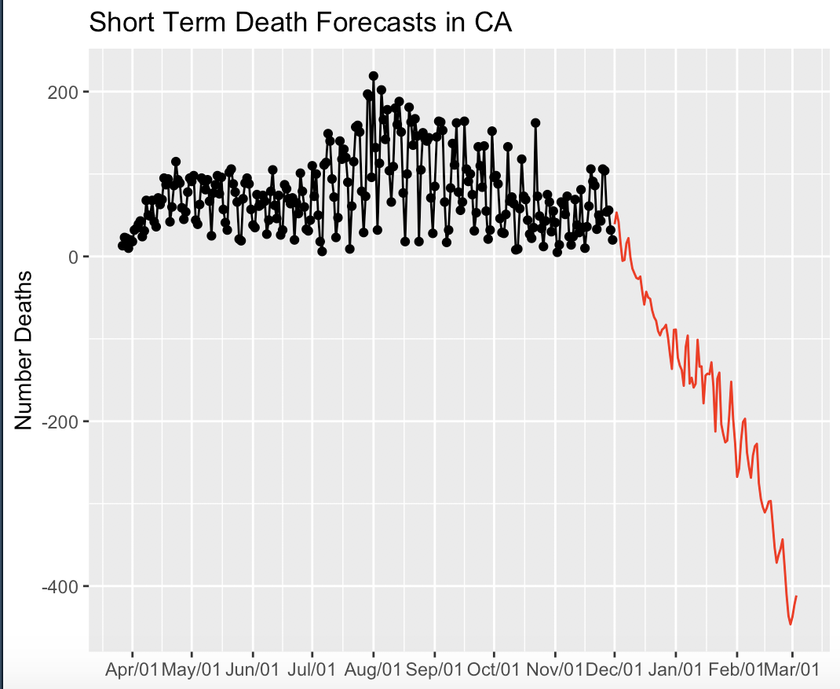
Forecasts
7 days
93 days

Slide 36

Ensemble ASE 637.5127

Slide 37

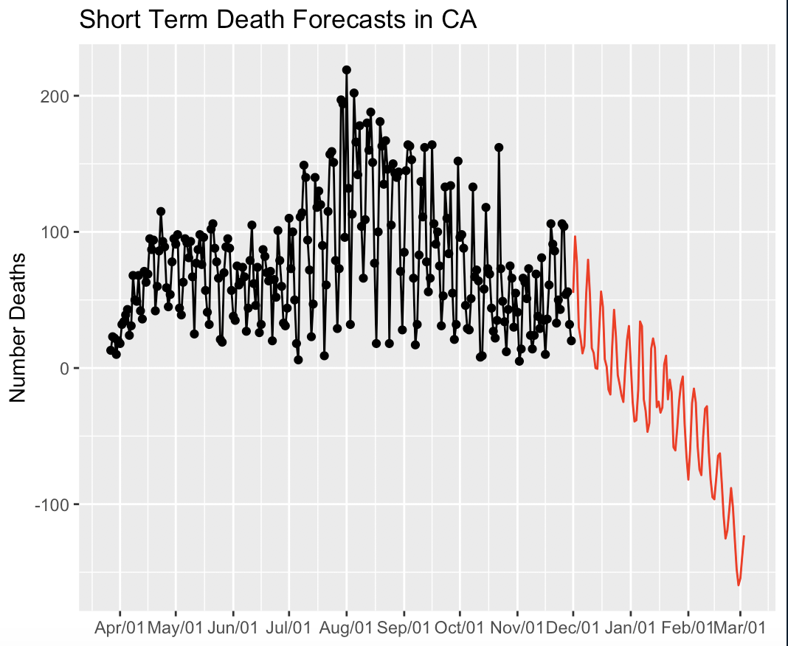
Ensemble Forecasts
7 days
93 days

Slide 38
US Notes
Filtered out US territories
Deaths, positive COVID cases, and negative COVID cases were cumulative -> needed to different to get daily data
Assumed Total Cases were the sum of reported negative and positive cases
Different states started reporting at different times
Most states started reporting around 3/9/2020 -> filter out data before
Decided to predict daily positive cases

Slide 39
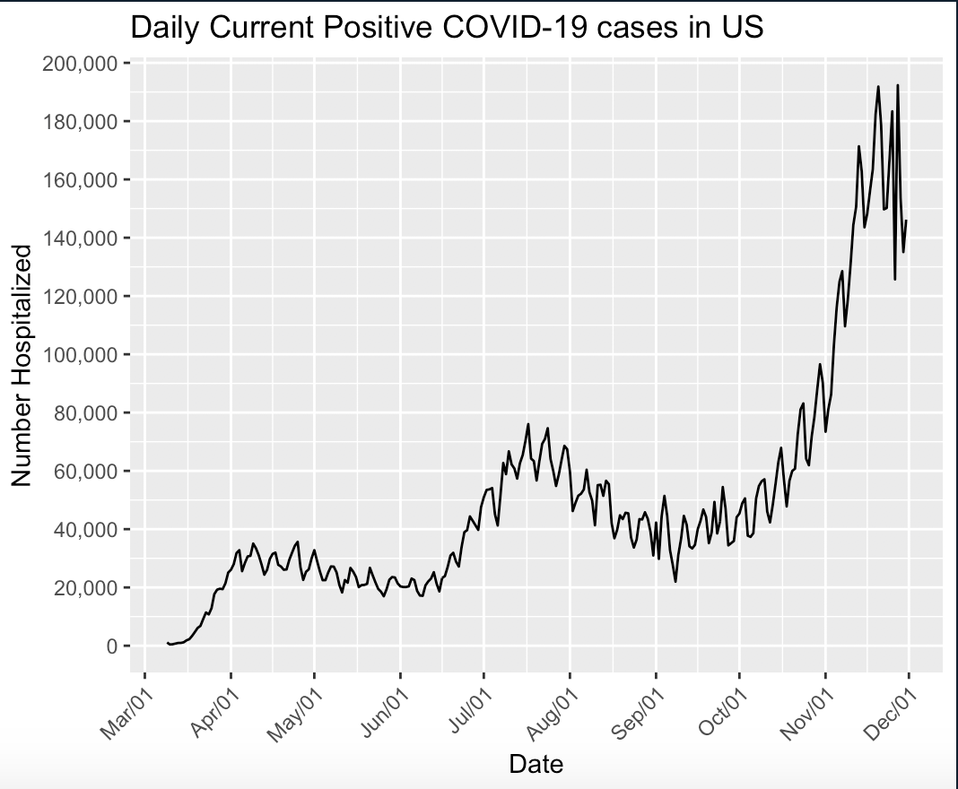
Daily Positive Cases

Slide 40
Univariate Forecasts
Predicted Daily Positive Cases for US

Slide 41
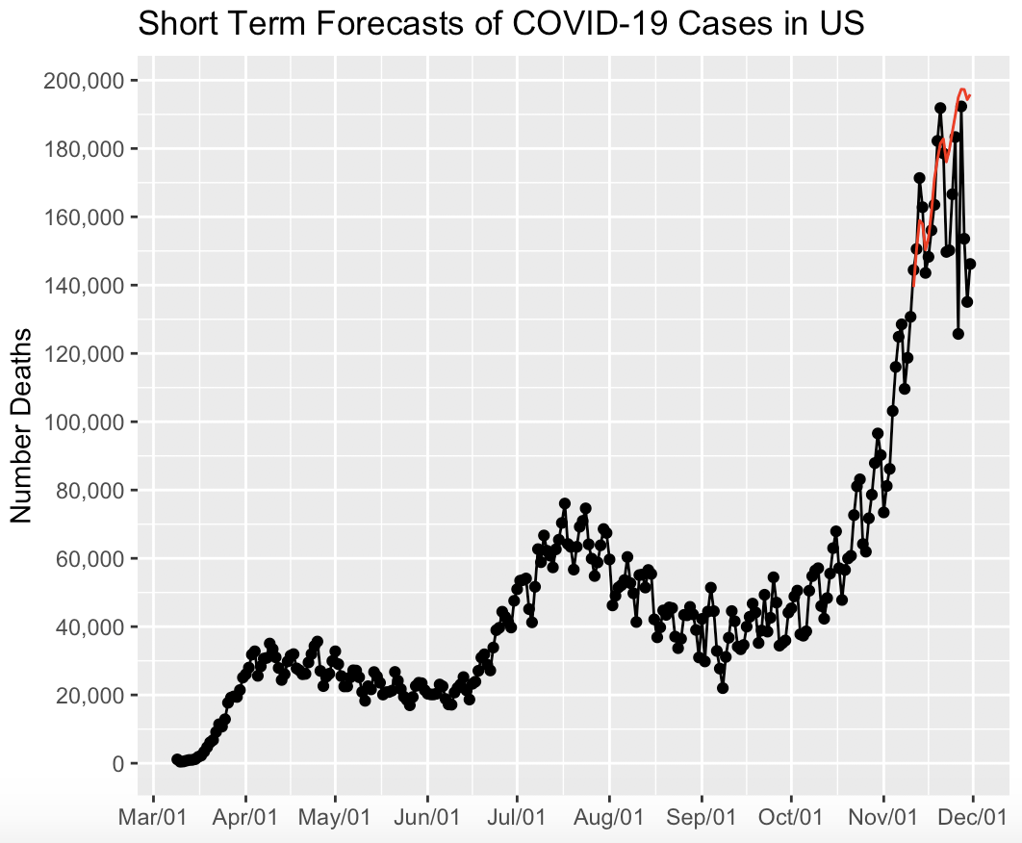
ARUMA ASE ASE=758368419

Slide 42
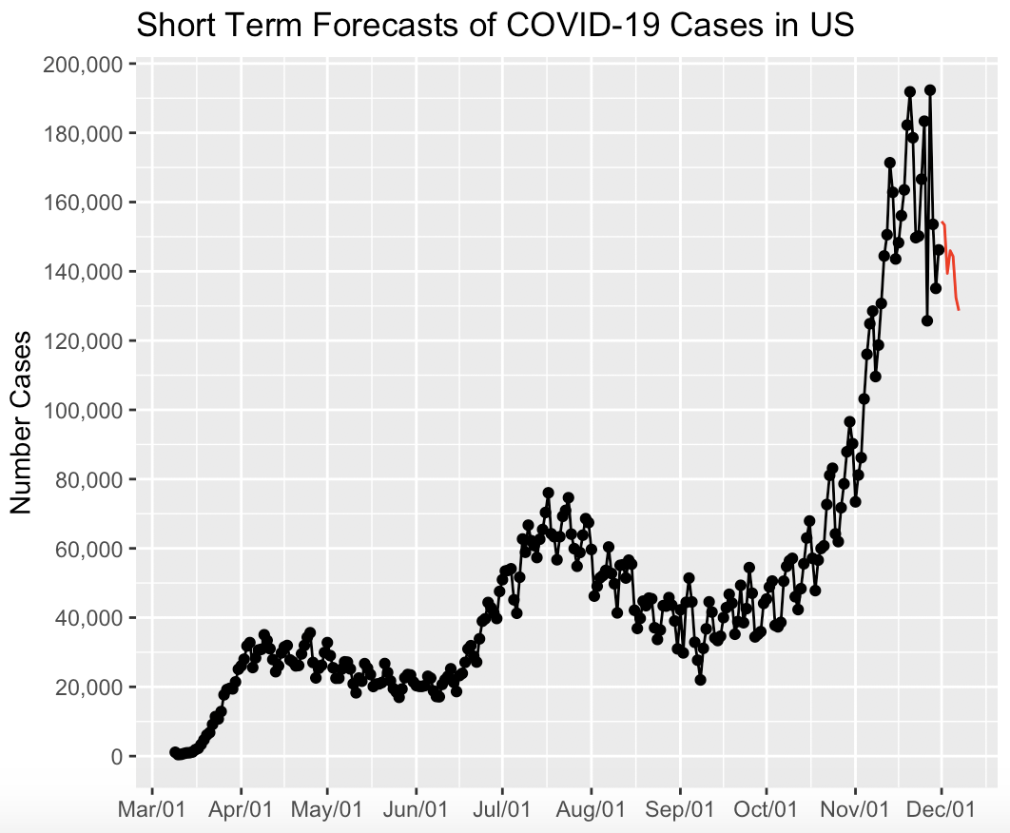
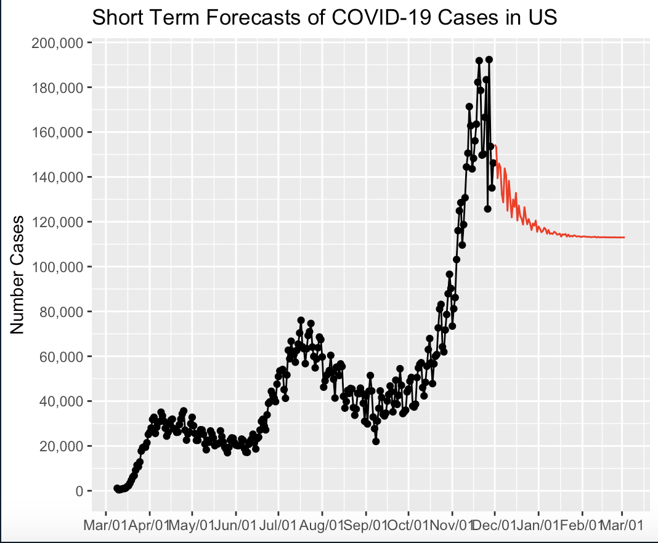
ARUMA forecasts
7 days
93 days

Slide 43
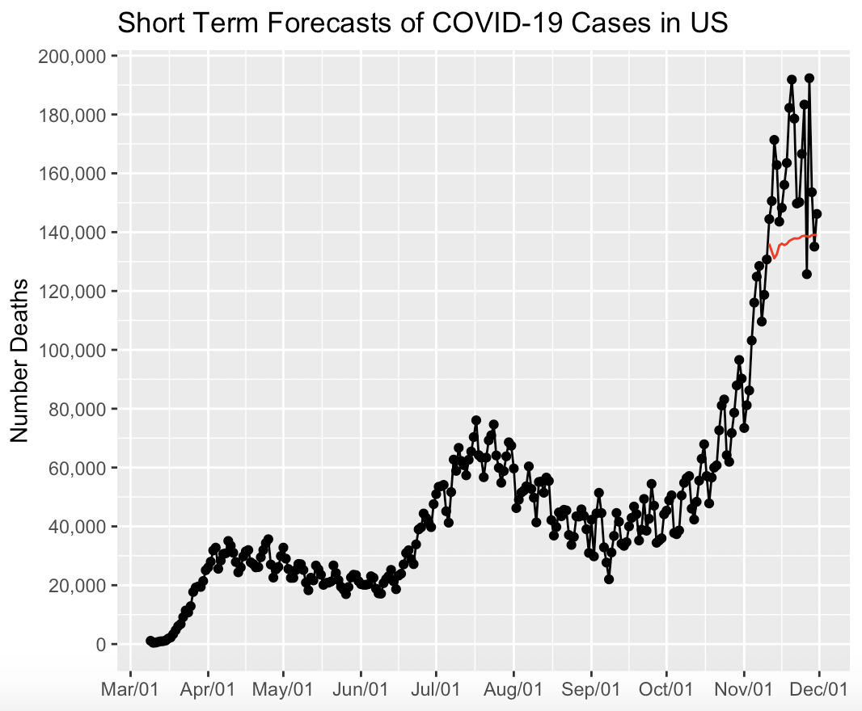
MLP ASE ASE=868256937

Slide 44
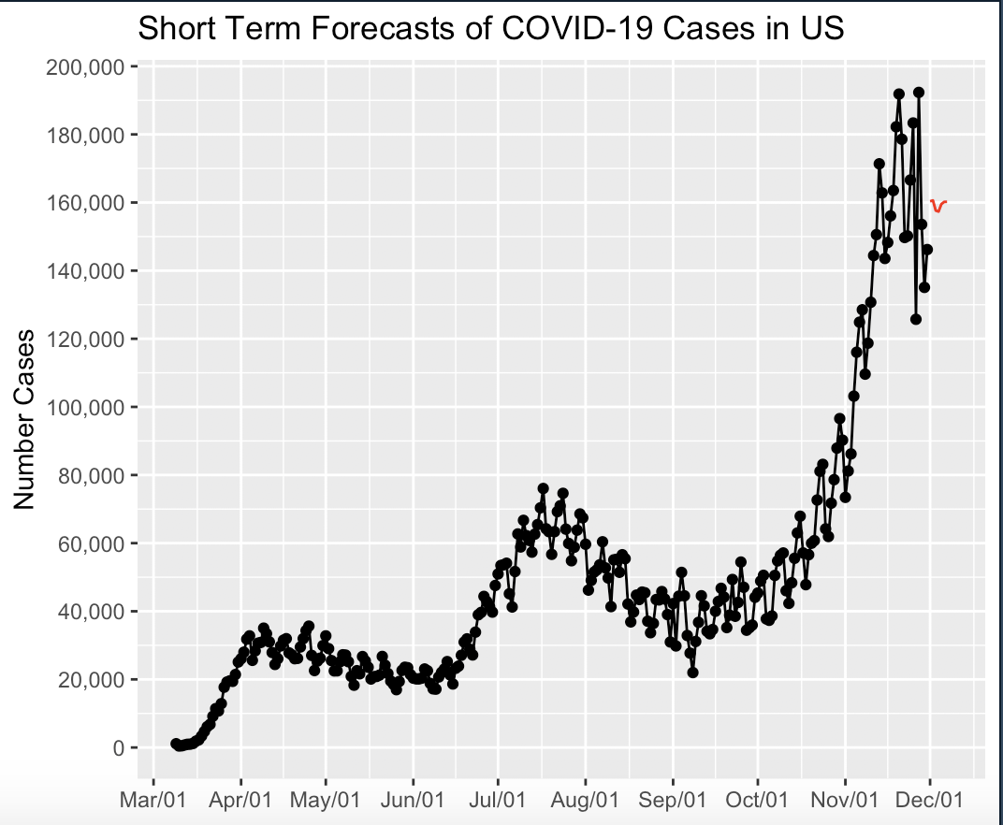
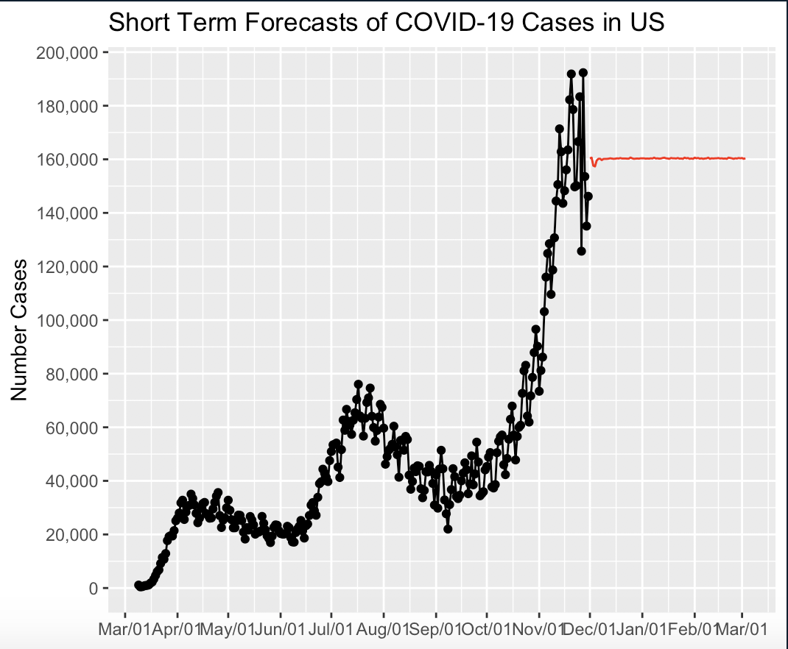
MLP forecasts
7 days
93 days

Slide 45

Ensemble ASE ASE=388684342

Slide 46


Ensemble Forecasts
7 days
93 days

Slide 47
Multivariate Forecasts
Predicted Daily Positive Cases in US using time and an indicator variable for whether it was a weekend

Slide 48

MLR ASE ASE = 296795079

Slide 49


MLR Forecasts
7 days
93 days

Slide 50
MLP ASE ASE = 232365226

Slide 51
MLP Forecasts
7 days
93 days

Slide 52

Ensemble ASE ASE=257982877

Slide 53


Ensemble Forecasts
7 days
93 days

Slide 54


Slide 55
JEREMY’S DAT & MODEL APPENDIX

Slide 56
Hospitalization Data by State
Total # of missing values
Data of first hospitalization record
state | total_missing | first_date
NE | 61 | 2020-06-02
NV | 33 | 2020-05-09
IN | 24 | 2020-04-24
DC | 18 | 2020-05-03
KY | 9 | 2020-04-09
MI | 8 | 2020-04-08
IL | 6 | 2020-04-06
WV | 6 | 2020-04-09
MO | 3 | 2020-04-03
WA | 3 | 2020-04-03

Slide 57
Stats by Day of the Week
Total Death
Total Positive Cases
Total Negative Cases
Total # of Tests
Positivity Rate [Positive / Total]
Mortality Rate [Death / Total]
day_of_week | totalDeath | totalPos | totalNeg | totalTests | percPos | percDeath
Wednesday | 50859 | 2062451 | 20688454 | 22750905 | 0.09065358 | 0.0022354715
Thursday | 43661 | 1946713 | 21892835 | 23839548 | 0.08165897 | 0.0018314525
Friday | 40905 | 2162485 | 24524578 | 26687063 | 0.08103121 | 0.0015327651
Saturday | 36444 | 2010771 | 23368583 | 25379354 | 0.07922861 | 0.0014359704
Tuesday | 41060 | 1694827 | 19865053 | 21559880 | 0.07861022 | 0.0019044633
Sunday | 21722 | 1577595 | 20305809 | 21883404 | 0.07209093 | 0.0009926244
Monday | 21235 | 1538397 | 20678326 | 22216723 | 0.06924500 | 0.0009558115

Slide 58
Top 5 States by Total Positive
state | totalPos | totalNeg | totalDeath | totalTests | posRate | deathRate
CA | 1183320 | 22389862 | 19089 | 23573182 | 0.05019772 | 0.0008097761
TX | 1151069 | 9485780 | 21309 | 10636849 | 0.10821522 | 0.0020033188
FL | 969813 | 6197289 | 18677 | 7167102 | 0.13531452 | 0.0026059347
IL | 712936 | 9655342 | 12838 | 10368278 | 0.06876127 | 0.0012381998
NY | 634438 | 18480766 | 26632 | 19115204 | 0.03319023 | 0.0013932365
GA | 418936 | 3870088 | 9424 | 4289024 | 0.09767630 | 0.0021972365

Slide 59
Top 5 States by Total Death
state | totalPos | totalNeg | totalDeath | totalTests | posRate | deathRate
NY | 634438 | 18480766 | 26632 | 19115204 | 0.03319023 | 0.0013932365
TX | 1151069 | 9485780 | 21309 | 10636849 | 0.10821522 | 0.0020033188
CA | 1183320 | 22389862 | 19089 | 23573182 | 0.05019772 | 0.0008097761
FL | 969813 | 6197289 | 18677 | 7167102 | 0.13531452 | 0.0026059347
NJ | 330275 | 5613309 | 16965 | 5943584 | 0.05556832 | 0.0028543384
IL | 712936 | 9655342 | 12838 | 10368278 | 0.06876127 | 0.0012381998

Slide 60
Top 5 States by Positivity Rate
state | totalPos | totalNeg | totalDeath | totalTests | posRate | deathRate
SD | 79099 | 246277 | 942 | 325376 | 0.2431003 | 0.002895112
ND | 77935 | 269446 | 680 | 347381 | 0.2243502 | 0.001957505
ID | 98500 | 385159 | 909 | 483659 | 0.2036559 | 0.001879423
KS | 153021 | 659403 | 1529 | 812424 | 0.1883512 | 0.001882022
IA | 199683 | 863998 | 2360 | 1063681 | 0.1877283 | 0.002218710
WY | 31929 | 138904 | 215 | 170833 | 0.1869018 | 0.001258539

Slide 61
Top 5 States by Mortality Rate
state | totalPos | totalNeg | totalDeath | totalTests | posRate | deathRate
MS | 149940 | 947272 | 3779 | 1097212 | 0.13665545 | 0.003444184
PA | 351667 | 2804464 | 10275 | 3156131 | 0.11142345 | 0.003255568
MA | 222469 | 3104965 | 10676 | 3327434 | 0.06685903 | 0.003208478
AZ | 322774 | 1905019 | 6624 | 2227793 | 0.14488509 | 0.002973346
SD | 79099 | 246277 | 942 | 325376 | 0.24310029 | 0.002895112
NJ | 330275 | 5613309 | 16965 | 5943584 | 0.05556832 | 0.002854338

Slide 62
US - Positive Cases

Slide 63


US Positive Cases: ARUMA(2,1,0) s=7 Forecasts
Phi = (-0.676, -0.2474)
sigma^2 = 48449346
mu = 52985.72
s = (1 - .7B^7)

Slide 64

US Positive Cases: ARUMA(2,1,0) s=7 Evaluation
ASE
Horizon = 20
Score: 320,475,065
Rolling Window ASE
Window size = 50
Score: 1,195,687,08

Slide 65


US Positive Cases: MLP Univariate Forecasts
MLP fit with 5 hidden nodes and 50 repetitions.
Series modelled in differences: D1D7.
Univariate lags: (1,2)
Forecast combined using the median operator.
MSE: 48161523.4569.

Slide 66

US Positive Cases: MLP Univariate Evaluation
ASE
Horizon = 20
Score: 1,240,337,749

Slide 67


US Positive Cases: VAR(7) Multivariate Forecasts
Explanatory Variables:
Lagged Hospitalized Patients
Lagged Deaths [i.e. do last week’s deaths predict infections this week]

Slide 68

US Positive Cases: VAR(7) Multivariate Evaluation
ASE
Horizon = 20
Score: 851,065,445

Slide 69


US Positive Cases: MLP Multivariate Forecasts
Explanatory Variables:
Lagged Hospitalized Patients
Lagged Deaths [i.e. do last week’s deaths predict infections this week]

Slide 70

US Positive Cases: MLP Multivariate Evaluation
ASE
Horizon = 20
Score: 555,527,771

Slide 71


US Positive Cases: Ensemble Univariate Forecast & Eval
Average of ARUMA(2,1,0) s=7 and MLP Univariate
ASE: 600,912,376 on horizon of 20

Slide 72
CA Death

Slide 73


CA Deaths: VAR(7) Forecasts
Explanatory Variables:
Lagged Hospitalizations
Lagged Daily Deaths

Slide 74

CA Deaths: VAR(7) Evaluation
ASE
Horizon = 20
Score: 2891.747

Slide 75
CA - Positive Cases

Slide 76


CA Positive Cases: ARIMA(12,1,0) Forecasts
Phi = (-0.4049 -0.4858 -0.2984 -0.0645 -0.0229 -0.0145 0.1090 0.1552 0.0322 0.0174 0.0394 -0.1903)
sigma^2 = 1,740,969
mu = 4876.203

Slide 77

CA Positive Cases: ARIMA(12,1,0) Evaluation
ASE
Horizon = 20
Score: 30,282,141
Rolling Window ASE
Window size = 50
Score: 12,621,120

